Slide 1


Econ251 Tutorial #1
Agenda :
Access World Bank Data
Use of MS excel for data analysis and presentation : Charts, computing average, correlation value, interpret trends and outliers
Preparation for Assignment 1
Demo and hands on session on international data site

Slide 2
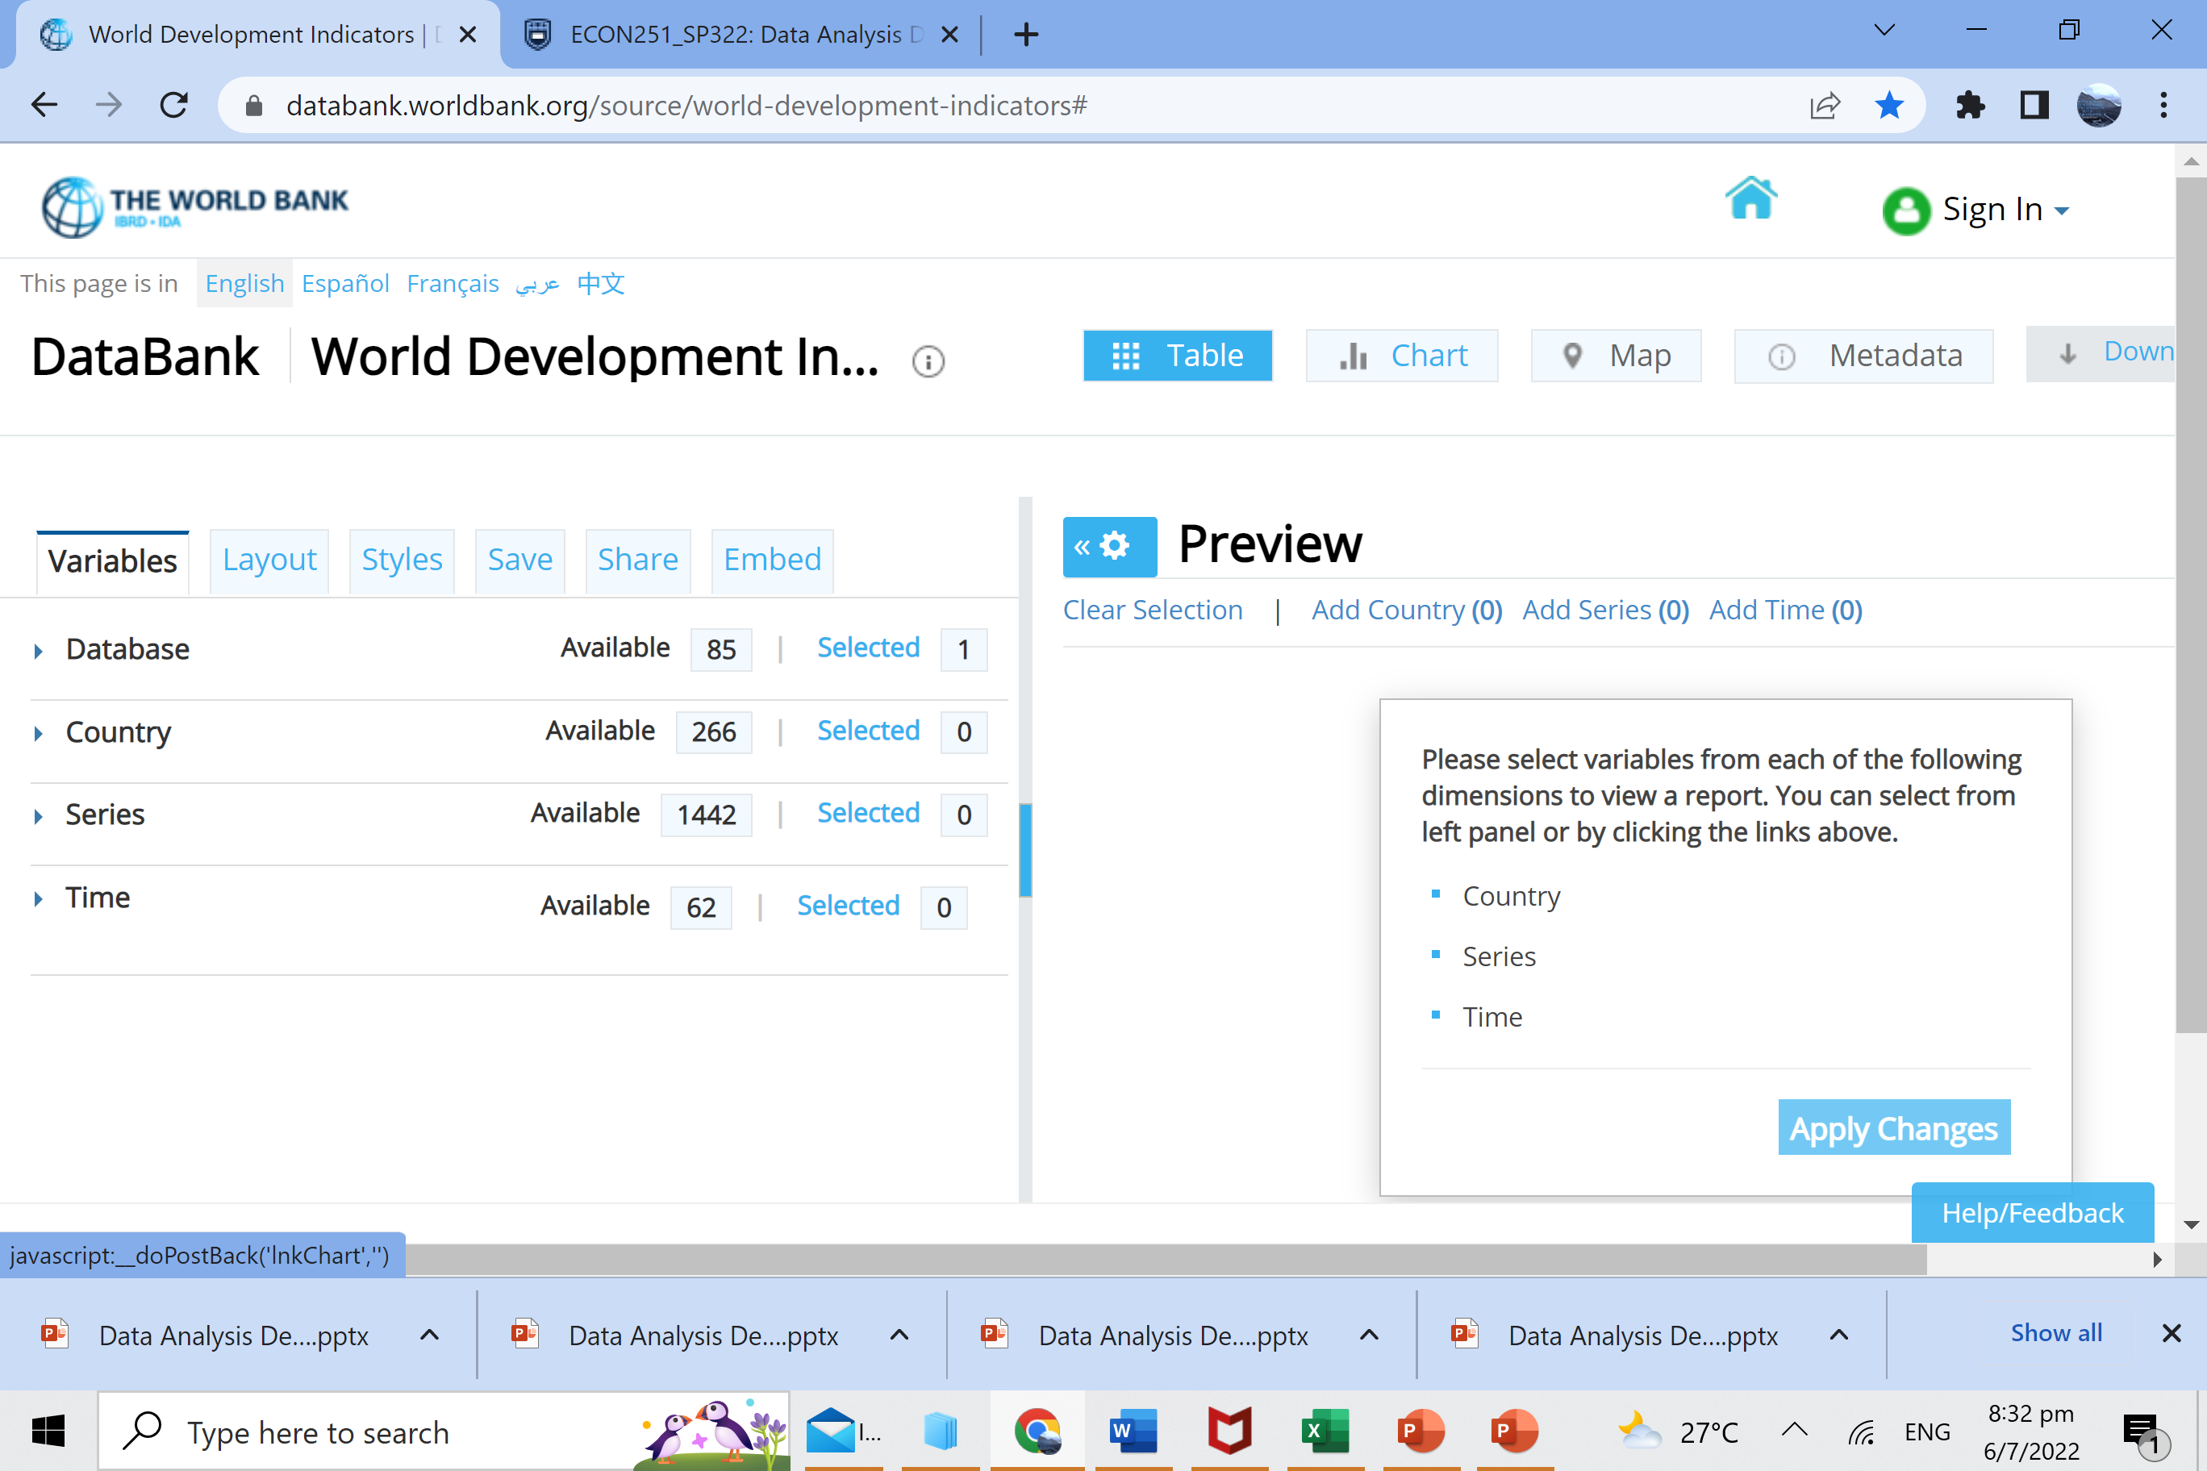
Accessing Data : An overview
Main Site
https://databank.worldbank.org/source/world-development-indicators#
Country(s)
Data Series
Time frame
Plan AHEAD

Slide 3
Accessing Data
Select the country(s)
Country(s)
Data Series
Time frame
May also select region(s): World, specific regions, income group

Slide 4
Accessing Data
You will spend most of your time, searching and making the selection . I recommend to select more items
Country(s)
Data Series
Time frame
e.g. Listed data provides unemployment rate but we need to consider only the employed workers
Some of the terminology used can be different
Stay consistent : choice of currency : USD especially if you are comparing between countries
Check clearly the units : in $? In % ?
Not all values are available ; in some cases, you need to do your own computation

Slide 5
Accessing Data
Minimum 7 years ; Select consecutive years
Country(s)
Data Series
Time frame

Slide 6
Accessing Data
1. Click apply changes
2. Check the preview :
Large amount of missing data ?
Do not be surprised many countries may not have the most recent years data
3. Modify your selection if necessary
Country(s)
Data Series
Time frame
2
1

Slide 7
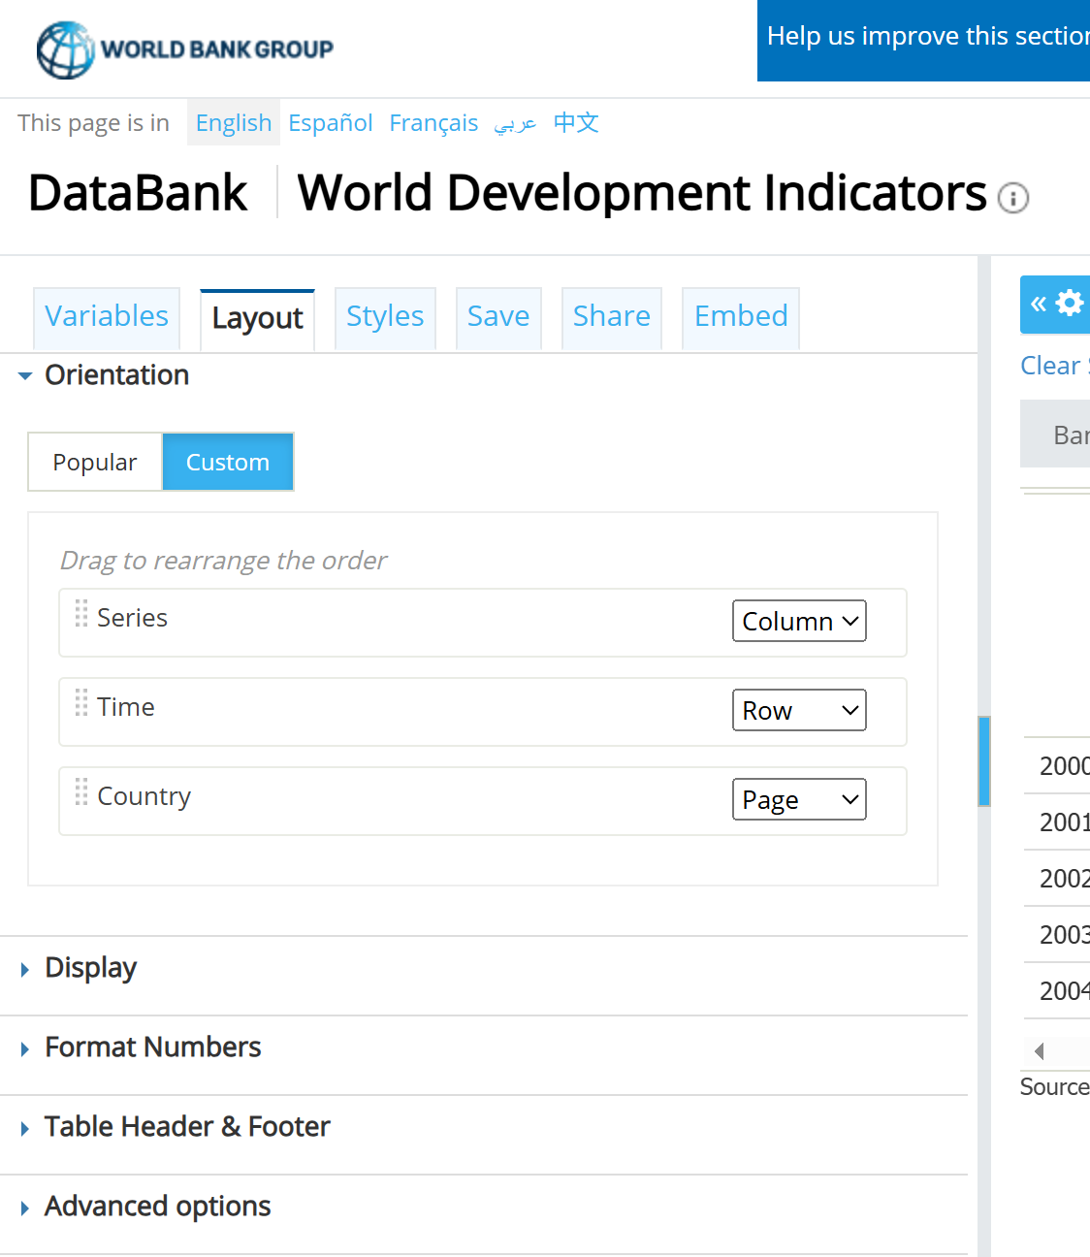
Accessing Data
1
Country(s)
Data Series
Time frame
2
3
Check formatting before you download so you spend less time formatting it on excel

Slide 8
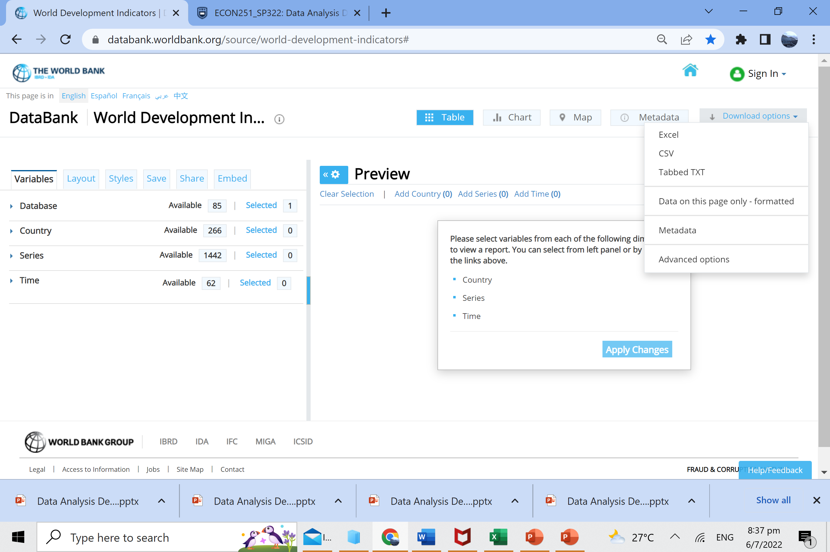
Accessing Data
Country(s)
Data Series
Time frame
1
2
1. Click on download
2. Save the file as Excel , label the excel sheet as RAW DATA
3. Advisable to copy the required data into separate sheets
4. See sample excel sheet in next slide

Slide 9
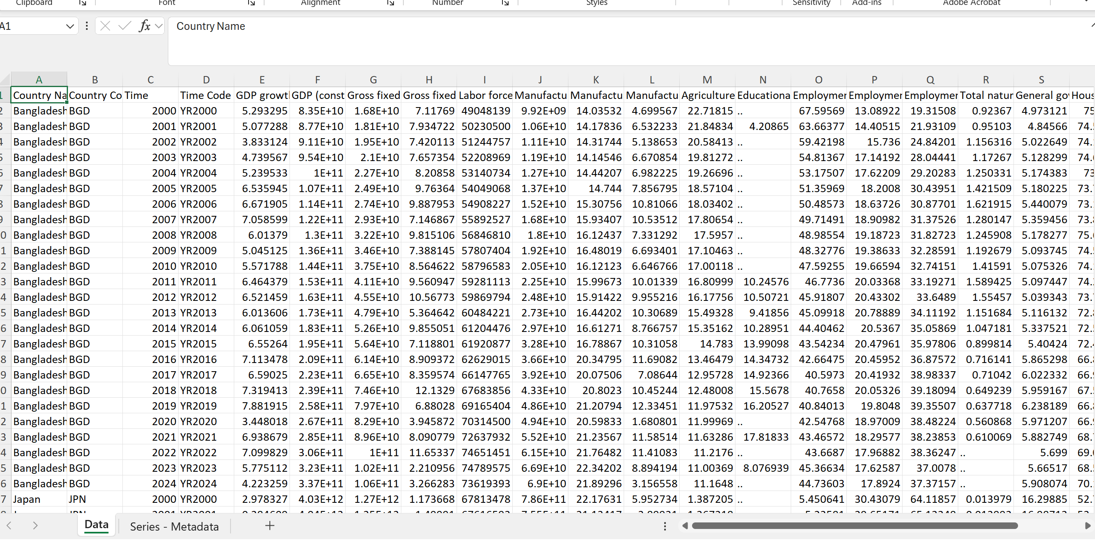
Sample excel download
Suggest to remove column B and D
B
D
Missing data : LEAVE IT AS IT IS
See next section on managing missing data
Create individual sheets of each country and copy the headers with data to the corresponding sheet

Slide 10
Sample excel download
Convert to currency ($) for column with values presented as E+_

Slide 11

Managing and preparing data
This Photo by Unknown Author is licensed under CC BY-SA

Slide 12

Managing Data
Copy the data set of each country into a single worksheet so you do not mess up the raw data sheet
Do not round off the numbers
Use of ‘-’ and leaving it blank can have an impact when you use formulas in excel
**** DO NOT INSERT ZERO in missing cells as it will affect your computations

Slide 13
Managing Data
Managing missing data
Suggestions : Linear Interpolation
Case A:
If a missing data in btw 2 years : take the average
e.g. Unemployment rate
Year 2012 : 3.4%
Year 2013 : NA [ = (3.4+2.8)/2 = 3.1
Year 2014 : 2.8%

Slide 14
Managing Data
Case 2:
Missing data for 4 consecutive years
Year 2001 : 3.4%
Year 2002 – 2005 : NA
Year 2006 : 2.8%
Method :
Take the difference of 3.4 with 2.8% and divide number of INTERVALS = 5 ,to get a gap of -0.12 [=-0.6/5 ] and apply the to each ascending year as seen below
Adjusted
Year 2001: 3.4 %
Year 2002 : 3.4 – 0.12 = 3.38%
Year 2003 : 3.38 – 0.12 = 3.26%
Year 2004 : 3.26 – 0.12 = 3.14%
Year 2005 : 3.14 – 0.12 = 3.02%
Year 2006 : 2.8%
And indicated in your report or your chart the data in year 2002- 2005 are missing and presented data is based on linear interpolation

Slide 15
Managing Data
Example 3 :
Missing data in the final year(s) of study : Adjust the time period, moving one year or x years back
e.g. studied period is year 2001 to 2010 but there is missing data in year 2010
Method: Adjust the studied period to year 2000 to 2009
This looks like an easy method but do give careful consideration with this method.
The basis of selecting this method should depend on the key data series that is affected.
And if you find yourself covering data with < 50% of the stated period then you should change the data source

Slide 16

Interpreting and Analysing data
Using excel function to compute average
Average : A quick summary and comparison btw countries.
This is performed by excel where you apply the function one time and drag it across the time period of study

Slide 17

Data presentation

Slide 18
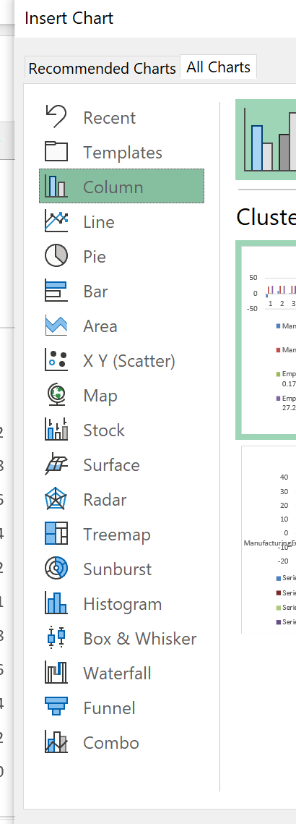

Type of charts
Line charts : To show growth and development with the use of trend lines
Stacked Bar charts : To show the components and their growth
Pie chart : to present the components in a single time period
Scatterplot charts : To present the relationship of 2 variables and their changes over time
Combo charts with use of secondary axis : Plotting 2 more or series where the data points are too varied. E.g. GDP is in billion dollars vs GDP per person in thousands.
For specific demo on the use of each chart, refer to the resources provided by Ms Excel or various YouTube channels

Slide 19
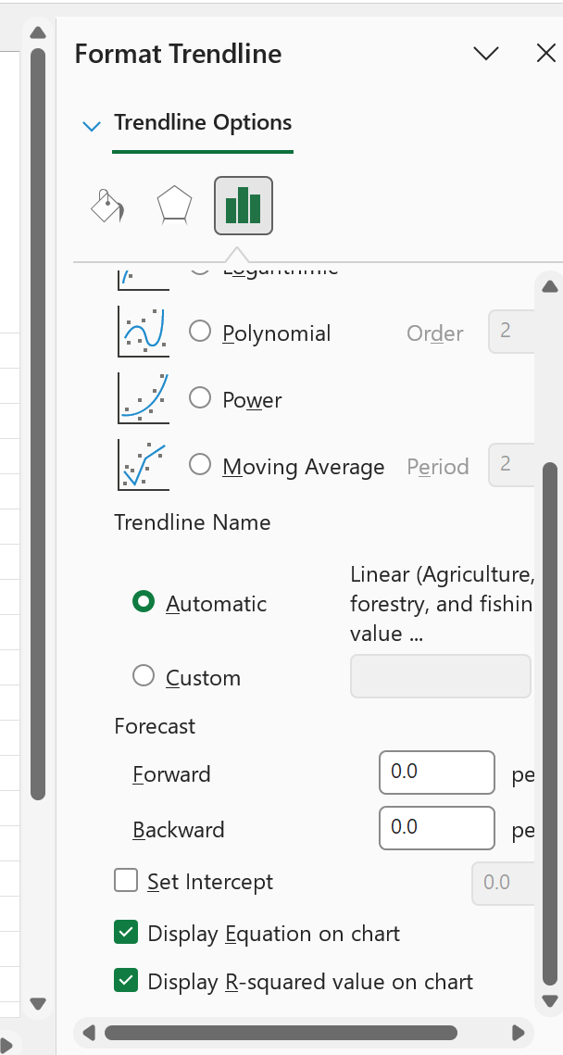
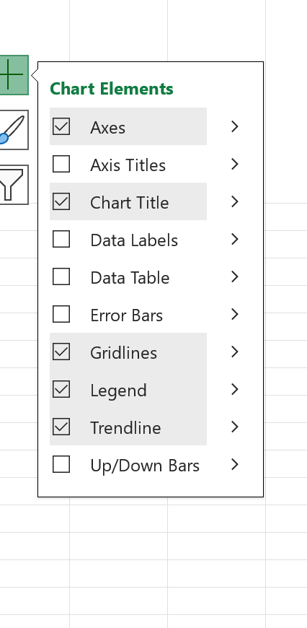
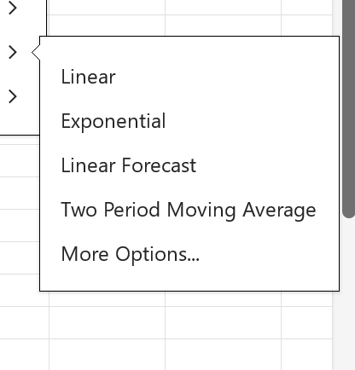
Presenting data
4
1
Charts are to tell a simple story and one way to do so is to use TREND LINE
See steps 1 and 5ingiven example
3. You will see a straight line plotted, then an equation and value of R2
2
3

Slide 20
Presenting data
Header is not clear at all
Should be RGDP (USD)
Trend line is not clear
Axis need not start from zero
Incorrect; it should be the years e.g. 2009

Slide 21
Presenting data
Keep the chart simple. No need to indicate the points of the chart. We are not interested in the specific data of each time period

Slide 22
Presenting data
Secondary axis
In this case we are using the secondary axis as the data on the right barely reach 0.1% while the second data series starts from 5%
Refer to next slide for key instructions

Slide 23
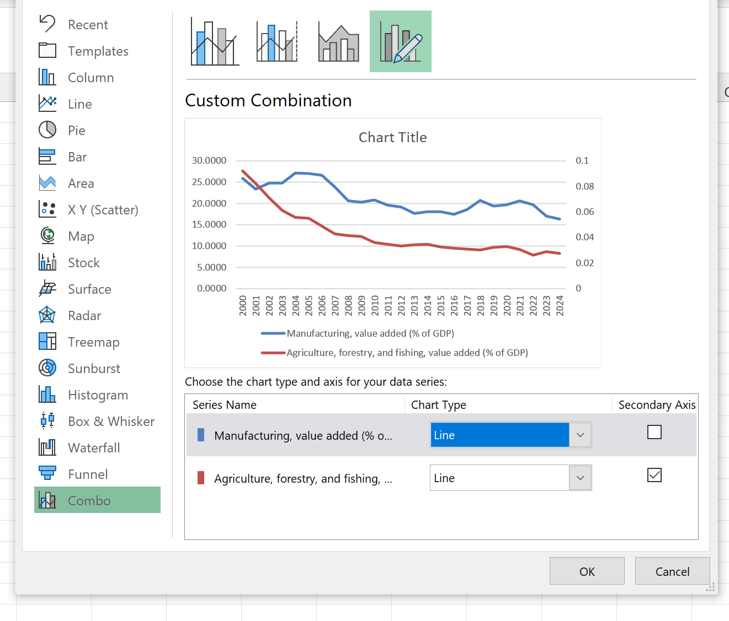
Use of Secondary axis
2
1

Slide 24
Using scatterplots
Effect , Y
The Left-to-Right Rule : Excel reads columns sequentially. When you highlight two columns to create a scatterplot:
The Left Column is automatically plotted on the Horizontal X-Axis (your Independent Variable / Cause).and the Right Column is automatically plotted on the Vertical Y-Axis (your Dependent Variable / Effect).Action:
Perfect Row Alignment (Time-Series Matching)A scatterplot requires ordered pairs $(x, y)$ that exist at the exact same point in time.
See sample answer in next slide
Cause, X
Manufacturing, value added (% of GDP) | Employment in agriculture (% of total employment) (modelled ILO estimate)
25.86149 | 0.176899
23.3947 | 0.173741
24.73764 | 0.169448
24.76541 | 0.164597
27.11937 | 0.159701
27.07676 | 0.155212
26.57801 | 0.1507
23.82265 | 0.146455
20.58566 | 0.142311
20.27338 | 0.139064
20.8888
20.8889
Valid

Slide 25
Example of scatterplot
Trendline with eqn and R2
Effect
Interpret the x coefficient
Interpret R2 on trend reliability
Cause

Slide 26

Part 1: Interpreting trendlines
This Photo by Unknown Author is licensed under CC BY-SA

Slide 27
Data Analysis – The trendline
Interpret :
Coefficient of x is positive suggesting the rising trend where RGDP rises over time
Slope of 10billion means in each year, the expected rise in real GDP by this value

Slide 28
Data Analysis – The trendline
Interpret :
R2: Fit of the data >50%
89% of the variance (the ups and downs) in your dependent variable ($y$) is explained by the changes in your independent variable ($x$).

Slide 29
Data Analysis – The trendline
Interpret :
R2: Fit of the data >50%
89% of the variance (the ups and downs) in your dependent variable ($y$) is explained by the changes in your independent variable ($x$).

Slide 30
Data Analysis – The trendline
Discuss and compare the slope
The negative coefficients of x for both series confirm that both variables are trending downward over time.
Given the coefficient of x of manufacturing is larger (0.365 vs 0.0021), this suggest the changes in manufacturing share of GDP Is faster than the agriculture sector
2) Discuss and compare R2
However, the explanatory power differs between the two models. The first series yields an $R^2$ of 0.739, which is visibly lower than the second series' $R^2$ of 0.89. This indicates that the linear trendline provides a tighter, more robust fit for the second series, explaining 89% of its total variance compared to roughly 74% for the first.

Slide 31
Part 2: Running regressions
This Photo by Unknown Author is licensed under CC BY-SA

Slide 32
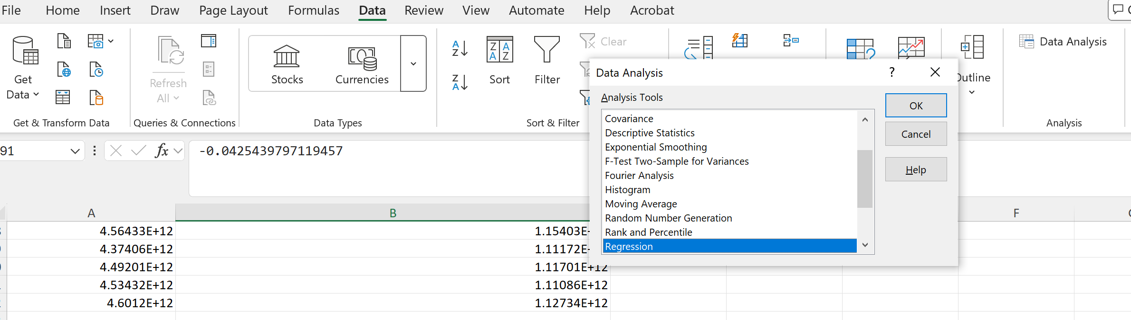
Demo 3: Running Regression Using Excel ToolPak
1
2
3

Slide 33
Preparing the data
NOTE:
The data must be set up in column format :
We do not need the time period but he studied data series must exist in each row
The units of measurement must be the same , example as seen in the example below, the unit is %. You cannot run a regression with a column of data in $ and other series in %.
% labour productivity | growth of capital per employed | Growth of H | Manufacturing, value added (annual % growth)
2.215% | 2.62% | -1.50030899 | 11.92191
3.916% | 10.10% | 1.028610229 | 5.940867
-5.791% | 2.43% | 2.622737885 | -4.18847
-1.443% | 3.83% | 0.32201004 | -4.1503
8.624% | 1.25% | 5.746429443 | 29.67534
3.299% | 3.45% | 0.459590912 | 7.807767
0.473% | 4.51% | 1.747440338 | 0.319107
3.200% | 4.52% | 1.319259644 | 1.671276
1.022% | 1.30% | 1.15071106 | 2.68312
0.165% | -0.82% | 0.888420105 | -5.1278
2.954% | -0.24% | 0.745517731 | 3.701001
4.856% | 5.49% | 1.445590973 | 10.40612
2.768% | -5.58% | 1.528499603 | 7.0287
-1.091% | 0.06% | 1.489292145 | -1.4551
-2.162% | -12.56% | 1.036251068 | 7.530706
11.858% | 25.55% | 3.551319122 | 13.30354
0.796% | 1.35% | 1.249469757 | 2.699762

Slide 34
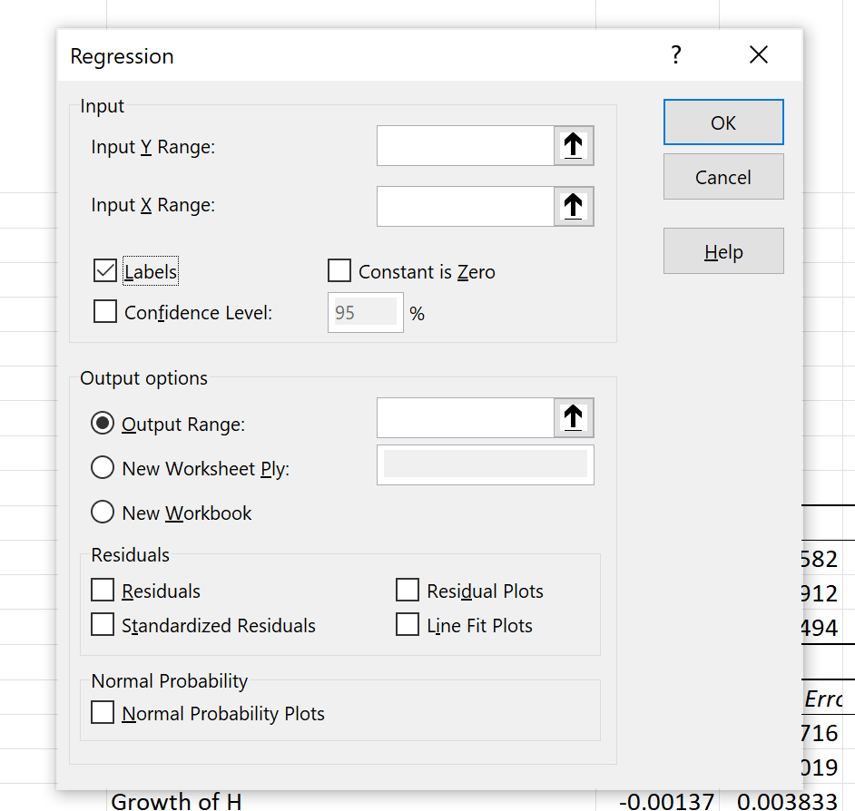
1
% labour productivity | growth of capital per employed | Growth of H | Manufacturing, value added (annual % growth)
2.215% | 2.62% | -1.50030899 | 11.92191
3.916% | 10.10% | 1.028610229 | 5.940867
-5.791% | 2.43% | 2.622737885 | -4.18847
-1.443% | 3.83% | 0.32201004 | -4.1503
8.624% | 1.25% | 5.746429443 | 29.67534
3.299% | 3.45% | 0.459590912 | 7.807767
0.473% | 4.51% | 1.747440338 | 0.319107
3.200% | 4.52% | 1.319259644 | 1.671276
1.022% | 1.30% | 1.15071106 | 2.68312
0.165% | -0.82% | 0.888420105 | -5.1278
2.954% | -0.24% | 0.745517731 | 3.701001
4.856% | 5.49% | 1.445590973 | 10.40612
2.768% | -5.58% | 1.528499603 | 7.0287
-1.091% | 0.06% | 1.489292145 | -1.4551
-2.162% | -12.56% | 1.036251068 | 7.530706
11.858% | 25.55% | 3.551319122 | 13.30354
0.796% | 1.35% | 1.249469757 | 2.699762
1
X range
3
Click on any cell next to your data series

Slide 35
Multiple regression interpretation
Summary of findings
Number of observations
Fit of data : R2 >= 0.5 is considered a acceptable fit
Coefficient : examine the sign indicating relationship between x and y
*** p value : <= 0.005 suggesting the value plays a significant role in affecting y
2
1
3
4

Slide 36
Choice of economy
Break until 2.15pm
East Asia:
Hong Kong SAR , Macau SAR , Mongolia, South Korea
SOUTHEAST ASIA
Brunei, Burma (Myanmar), Cambodia, Timor-Leste, Indonesia, Laos, Malaysia, the Philippines Thailand and Vietnam.
In total you need to cover the data analysis of three economies i.e. including Japan and China

